Slide 1
Why exception specifiers are not good?
https://stackoverflow.com/questions/88573/should-i-use-an-exception-specifier-in-c/88905#88905

Slide 2
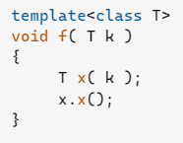
Template code is impossible to write
The copies might throw
The parameter passing might throw
And x() might throw some unknown exception.

Slide 3
2. Prohibit extensibility
virtual void open() throw( FileNotFound ); // not extensible
might evolve into
virtual void open() throw( FileNotFound, SocketNotReady,
InterprocessObjectNotImplemented,
HardwareUnresponsive ); // overambitious
You could really write that as
throw( ... ) // really what you mean, when write virtual function

Slide 4
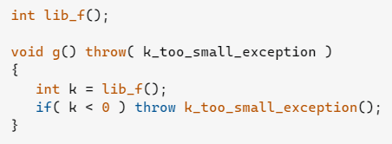
3. Legacy code
When relies on another library, you don't really know what it might do when something goes horribly wrong.
g will terminate, when lib_f() throws. This is (in most cases) not what you really want. std::terminate() should never be called. It is always better to let the application crash with an unhandled exception, from which you can retrieve a stack-trace, than to silently/violently die.

Slide 5
Exception best practices
Best Practices for exceptions - .NET | Microsoft Learn

